Slide 1
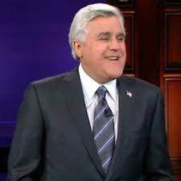
Who is this man?

Slide 3
Jay walking
http://videolicious.tv/2009/06/the-best-of-jaywalking-final-jay-leno-tonight-show/#.VK5xxWTF_-Vhttp://videolicious.tv/2009/06/the-best-of-jaywalking-final-jay-leno-tonight-show/ - .VK5xxWTF_-V

Slide 4
Your turn
Imagine jay stops you on the street and asks you a series of questions. Answer them as honestly as you can.
Each question is on a ppt slide.
Read the question and give your best verbal response.
Then move to the next slide.

Slide 5
Open up this ppt in screencastify.
Record your answers to each question.
So…. Open up this powerpoint in screencastify and click to the next page for the first question.

Slide 6
Question 1
What are the human sex cells called? (male and female?)

Slide 7
Question 2
Where are the human sex cells created? (male and female?)

Slide 8
Question 3
What happens at the moment of fertilization?

Slide 9
Question 4
In which part of the body does fertilization take place?

Slide 10
Question 5
Where does the baby develop?

Slide 11
Question 6
What are the egg and sperm carrying? How many of them are there?

Slide 12
Question 7
Approximately how many cells are in a adult human?

Slide 13
Question 8
How do we go from the cell created when sperm fertilizes egg to a full grown human with billions of cells?

Slide 14
Question 9
Why do have characteristics, personality traits etc that resemble each of my parents?

Slide 15
Nice job.
Please share your screencast with us.

