Slide 1
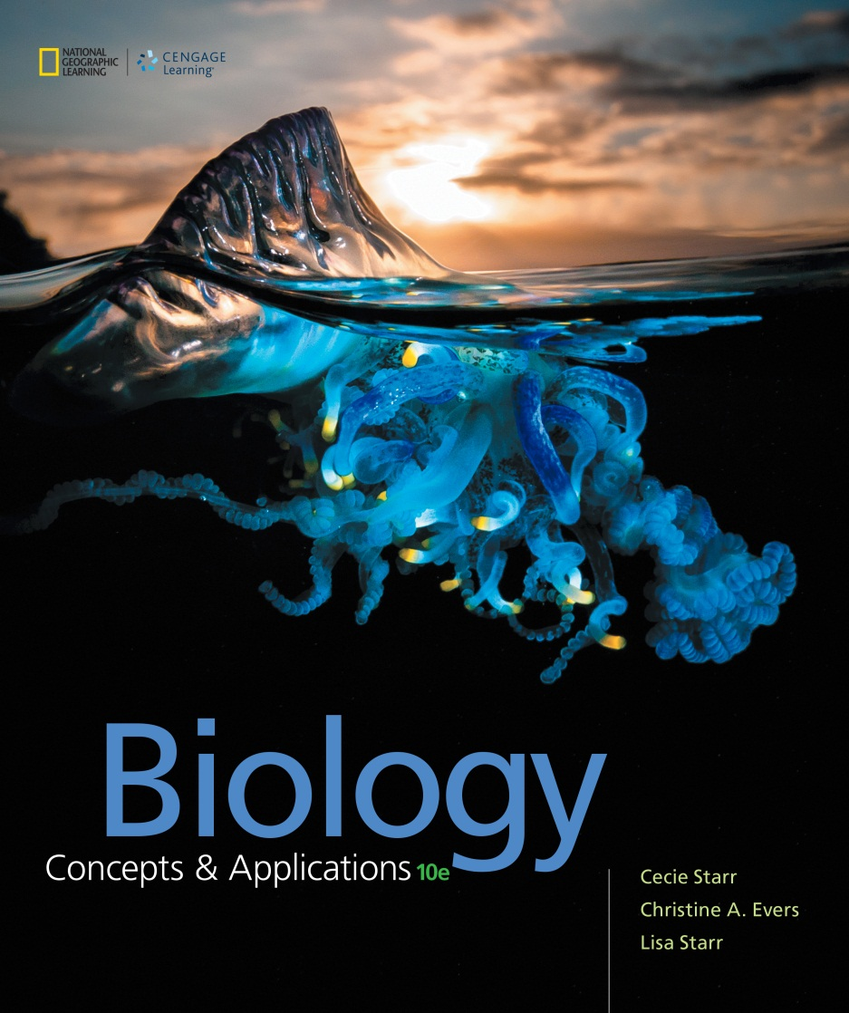
Biology Concepts & Applications
10 Edition
Chapter 5
Ground Rules of Metabolism
Copyright © 2018 Cengage Learning. All Rights Reserved. May not be copied, scanned, or duplicated, in whole or in part, except for use as permitted in a license distributed with a certain product or service or otherwise on a password-protected website for classroom use.

Slide 2
5.1 Life Runs on Energy
Energy: the capacity to do work
Kinetic energy: the energy of motion
First law of thermodynamics: energy cannot be created or destroyed
Entropy: measure of how much the energy of a system is dispersed
Second law of thermodynamics: energy disperses spontaneously

Slide 3
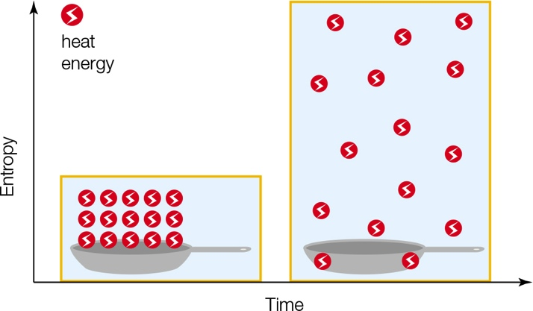
Entropy
Notes:
Figure 5.1 Entropy. Entropy tends to increase, which means that energy tends to spread out spontaneously. The total amount of energy in any system always stays the same.

Slide 4
Energy’s One-Way Flow
Work occurs as a result of energy transfers
  Energy lost from a transfer is usually in the form of heat
  Since heat is not useful for doing work, the total amount of energy available for doing work in the universe is always decreasing
  Lost energy must be replenished for life to continue

Slide 5
Solar Powered
The energy that fuels most life on Earth comes from the sun
  This energy from the sun is transferred many times until it is permanently dispersed
Energy’s spontaneous dispersal is resisted by chemical bonds
  Energy in chemical bonds is a type of potential energy (stored energy)

Slide 6
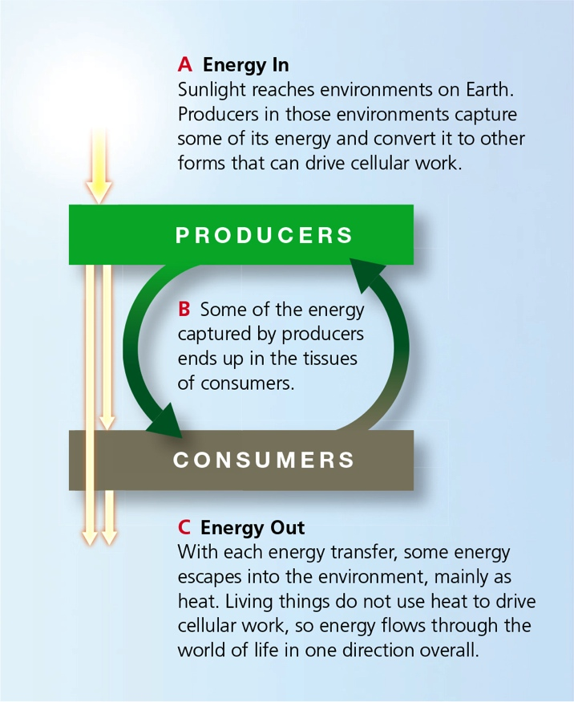
Energy Cycling
Notes:
Figure 5.3 Energy movement through the world of life.
Energy (yellow arrows) flows from the environment into living organisms, then back to the environment. The flow drives a cycling of materials (green arrows) among producers and consumers.

Slide 7
5.2 Energy in the Molecules of Life
During a reaction, one or more reactants become one or more products
  Reactant: molecule that enters a reaction and is changed by participating in it
  Product: molecule that is produced by a reaction

Slide 8
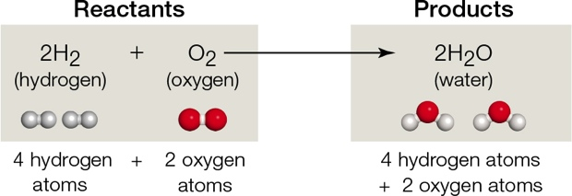
Chemical Bookkeeping
Notes:
Figure 5.5 Chemical bookkeeping.
In equations that represent chemical reactions, reactants are written to the left of an arrow that points to the products. A number before a formula indicates the number of molecules. Atoms may shuffle around in a reaction, but the same number of atoms that enter the reaction remain at the reaction’s end.

Slide 9
Chemical Bond Energy
Bond energy and entropy both contribute to a molecule’s free energy (amount of energy available to do work)
  Endergonic: energy in; reaction that requires a net input of free energy to proceed
  Exergonic: energy out; reaction that ends with a net release of free energy

Slide 10
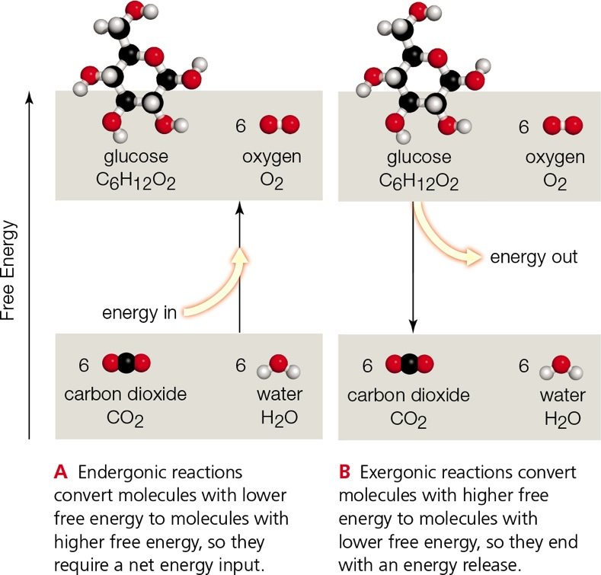
Ins and Outs of Energy
Notes:
Figure 5.6 The ins and outs of energy in chemical reactions.

Slide 11
Why Earth Does Not Go Up in Flames (1 of 2)
The molecules of life release energy when they combine with oxygen
  Example: a spark starts a reaction that converts cellulose (in wood) and oxygen (in air) to water and carbon dioxide
  The reaction is highly exergonic, causing wood to continue to burn

Slide 12
Why Earth Does Not Go Up in Flames (2 of 2)
Earth is rich in oxygen—and in potential exergonic reactions
  Why then doesn’t Earth burst into flames?
Chemical bonds do not break without at least a small input of energy
  Activation energy: the minimum amount of energy required to get a chemical reaction started

Slide 13
Energy In, Energy Out
Cells store energy by running endergonic reactions that build organic compounds
  Example: light energy drives the overall reactions of photosynthesis
Cells harvest energy by running exergonic reactions that break the bonds of organic compounds
  Example: aerobic respiration releases the energy of glucose

Slide 14
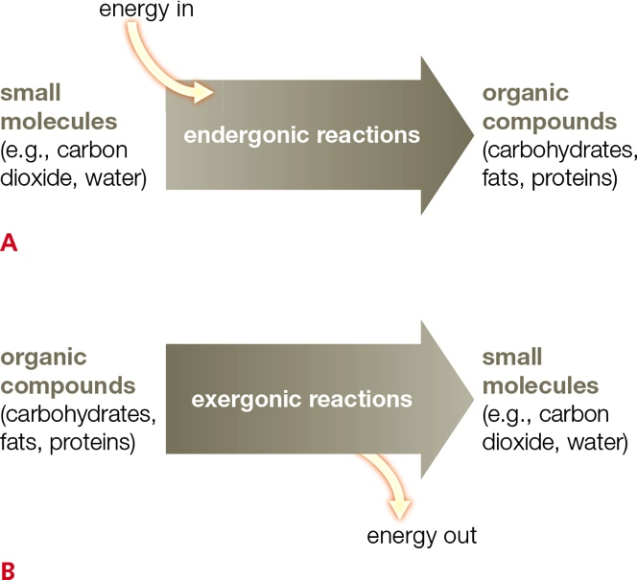
Energy in Bonds
Notes:
Figure 5.8 Cells store and retrieve energy in bonds.
A Cells run endergonic reactions to store energy in the bonds of organic compounds.
B Cells run exergonic reactions to retrieve energy stored in the bonds of organic compounds.

Slide 15
5.3 How Enzymes Work
Metabolism requires enzymes
In a process called catalysis, an enzyme makes a reaction run much faster than it would on its own

Slide 16
The Need for Speed (1 of 2)
Most enzymes are proteins
Each kind of enzyme recognizes specific substrates (reactants) that are altered in specific ways
  Active site: pocket in an enzyme where substrates bind and a reaction occurs

Slide 17
The Need for Speed (2 of 2)
Another way to think of activation energy:
  Energy required to bring reactant bonds to their breaking point (transition state)
At the transition state, the reaction can run without any additional energy input

Slide 18
The Active Site
Notes:
Figure 5.9 The active site. Each enzyme acts only on molecules (substrates) that “fit” its active site. For simplicity, active sites are often depicted as blobs or geometric shapes (A–C). The models in D show the actual contours of an active site in hexokinase, an enzyme that adds a phosphate group to glucose and other six-carbon sugars.
A An enzyme can act only on molecules that ‘fit’ its active site. Such molecules are called the enzyme’s substrates.
B An active site squeezes substrates together, influences their charge, or causes some change that lowers activation energy, so the reaction proceeds.
C The product leaves the active site after the reaction is finished. The enzyme is unchanged, so it can work repeatedly.
D Left, a glucose molecule meets up with a phosphate in the active site of hexokinase. Right, the enzyme has catalyzed the reaction, and the product, glucose-6-phosphate, is leaving its active site. Notice how the active site changes shape.

Slide 19
Reaching the Transition State
Enzymes help bring on the transition state by lowering activation energy via:
  Forcing substrates together
  Orienting substrates
  Inducing fit
  Shutting out water

Slide 20
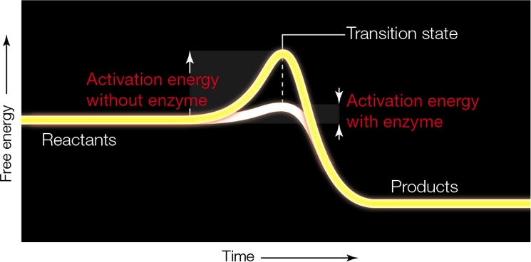
The Transition State
Notes:
Figure 5.10 The transition state. An enzyme enhances the rate of a reaction by lowering activation energy.

Slide 21
Influences on Enzyme Activity (1 of 3)
Environmental factors (e.g., pH, temperature, salt) influence an enzyme’s shape and function
  Each enzyme functions best in a particular range of conditions that reflect the environment in which it evolved

Slide 22
Influences on Enzyme Activity (2 of 3)
The enzyme pepsin digests proteins in the very acidic (pH 2) stomach environment
Pepsin denatures above pH 5.5
  Pepsin becomes inactivated when the stomach’s contents pass into the small intestine (pH 9)
The enzyme trypsin continues protein digestion in the small intestine at the higher pH

Slide 23
Influences on Enzyme Activity (3 of 3)
Adding heat boosts free energy, bringing reactants closer to activation energy
The rate of an enzymatic reaction typically increases with temperature — but only up to a point
  An enzyme denatures above a characteristic temperature, causing the reaction rate to fall sharply as the shape of the enzyme changes

Slide 24
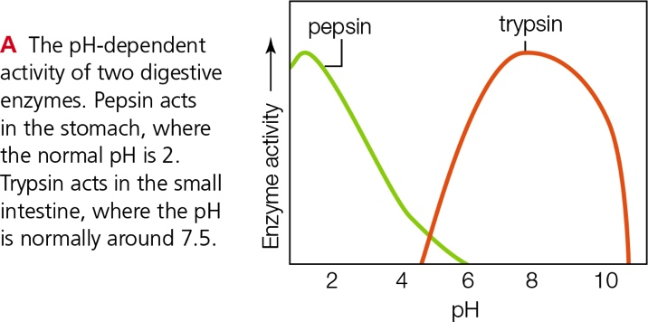
Enzymes and pH
Notes:
Figure 5.12 Enzymes, temperature, and pH.
Each enzyme functions best within a characteristic range of conditions—generally, the same conditions that occur in the environment where the enzyme is normally found.

Slide 25
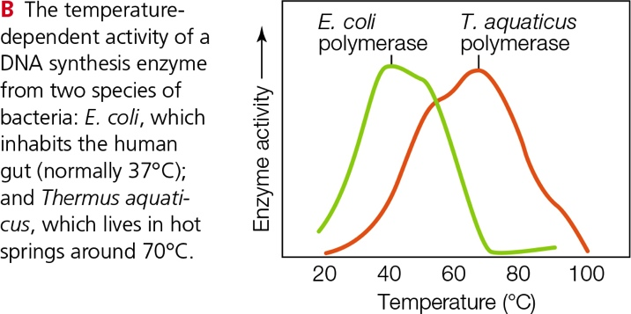
Enzymes and Temperature
Notes:
Figure 5.12 Enzymes, temperature, and pH.

Slide 26
5.4 Metabolic Pathways
Metabolic pathway: series of enzyme-mediated reactions by which cells build, remodel, or break down an organic molecule
  Linear pathway: reactions run straight from reactant to product
  Cyclic pathway: the last step regenerates a reactant for the first step

Slide 27
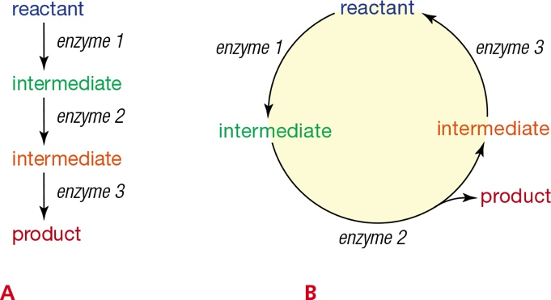
Linear and Cyclic Pathways
Notes:
Figure 5.13 Metabolic pathways.
A A linear pathway runs straight from reactant to product.
B The last step of a cyclic pathway regenerates a reactant for the first step.

Slide 28
Controls Over Metabolism (1 of 2)
What mechanisms help cells regulate the production of substances?
  The coupling of forward and reverse reactions
  Regulatory molecules or ions that bind directly to an enzyme’s active site
  Binding of an allosteric regulator (outside of the active site) alters the shape of an enzyme in a way that enhances or inhibits its function

Slide 29
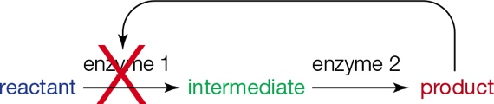
Controls Over Metabolism (2 of 2)
The end product of a series of enzymatic reactions often inhibits the activity of one of the enzymes in the series
  Feedback inhibition: regulatory mechanism; a change that occurs during a specific cellular activity suppresses that activity
Notes:
Figure 5.15 Feedback inhibition.
Here, two different enzymes act in series to convert a reactant to a product. The product inhibits the activity of the first enzyme.

Slide 30
Electron Transfers (1 of 3)
The bonds of organic molecules hold a lot of energy that can be released in a reaction with oxygen
  Burning involves a reaction with oxygen; energy from organic molecules is released all at once—explosively

Slide 31
Electron Transfers (2 of 3)
To facilitate burning, cells break organic molecules apart in small, manageable steps
  Most of these steps are oxidation–reduction reactions (redox reactions; electron transfers)
  In a typical redox reaction, one molecule accepts electrons (it becomes reduced) from another molecule (which becomes oxidized)

Slide 32
Electron Transfers (3 of 3)
Electron transfer chain: array of enzymes and other molecules that accept and give up electrons in sequence
  The energy of the electrons is released with each step of the sequence
  Important for photosynthesis and aerobic respiration

Slide 33
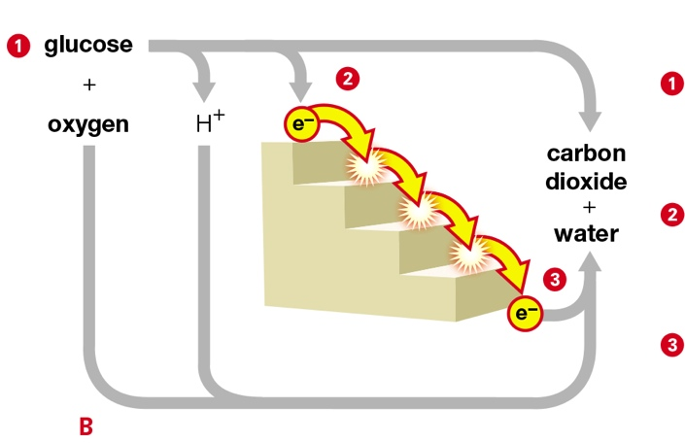
Electron Transfer Chain
Notes:
Figure 5.16 Comparing uncontrolled and controlled energy release. The overall reaction is the same in both cases.
B In cells, glucose reacts with oxygen in a stepwise fashion that involves an electron transfer chain, represented here by a staircase. Energy is released in amounts that cells are able to harness.
1 An input of activation energy splits glucose (C₆H₁₂O₆) into hydrogen ions (H⁺), electrons (e¯), and carbon dioxide (CO₂).
2 Electrons lose energy ( ) as they move through an electron transfer chain. Energy released by the electrons is harnessed for cellular work.
3 Electrons, hydrogen ions, and oxygen combine to form water.

Slide 34
5.5 Cofactors (1 of 2)
Cofactor: metal ion or organic compound that associates with an enzyme and is necessary for that enzyme’s function
  Examples: vitamins, minerals, metal ions
Coenzyme: an organic cofactor
  Example: coenzyme Q₁₀, NAD⁺

Slide 35
Cofactors (2 of 2)
The enzyme catalase has four tightly bound cofactors called hemes
  Catalase’s substrate is hydrogen peroxide, a highly reactive molecule that can be dangerous
  The heme in catalase breaks hydrogen peroxide into water
  Catalase is an antioxidant: prevents oxidation of other molecules

Slide 36
Coenzymes
TABLE 5.1
Some Common Coenzymes
Coenzyme | Example of Function
Ascorbic acid | Collagen fiber formation; carries electrons
(vitamin C) | during peroxide breakdown (in lysosomes)
ATP | Transfers energy with a phosphate group
NAD, NAD⁺ | Carries electrons during glycolysis
NADP, NADPH | Carries electrons, hydrogen atoms during
 | photosynthesis
FAD, FADH, FADH₂ | Carries electrons during aerobic respiration
CoA | Carries acetyl group (COCH₃) during
 | glycolysis
Coenzyme Q_{l0} | Carries electrons in electron transfer chains
 | of aerobic respiration
Biotin (vitamin B₇) | Carries C0₂ during fatty acid synthesis
Heme | Accepts and donates electrons
Notes:
Table 5.1 Some Common Coenzymes

Slide 37
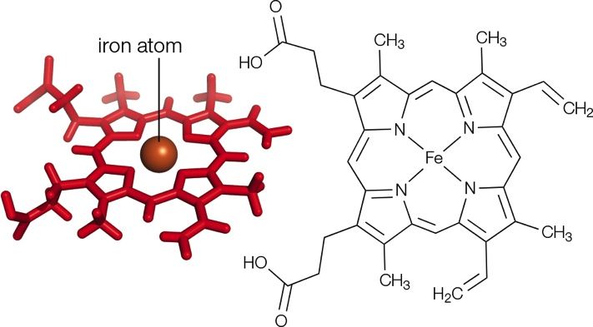
Heme
Notes:
Figure 5.19 Heme. This organic molecule is part of the active site in many enzymes (such as catalase). In other contexts, it carries oxygen (e.g., in hemoglobin) or electrons (e.g., in molecules of electron transfer chains).

Slide 38
ATP—A Special Coenzyme (1 of 3)
ATP (adenosine triphosphate) functions as a cofactor in many reactions
  Bonds between phosphate groups hold a lot of energy
  When a phosphate group is transferred via the process of phosphorylation, energy is transferred along with it

Slide 39
ATP—A Special Coenzyme (2 of 3)
ATP/ADP cycle:
  Process by which cells regenerate ATP
  ADP (adenosine diphosphate) forms when a phosphate group is removed from ATP, then ATP forms again as ADP gains a phosphate group
The ATP/ADP cycle couples endergonic reactions with exergonic ones

Slide 40
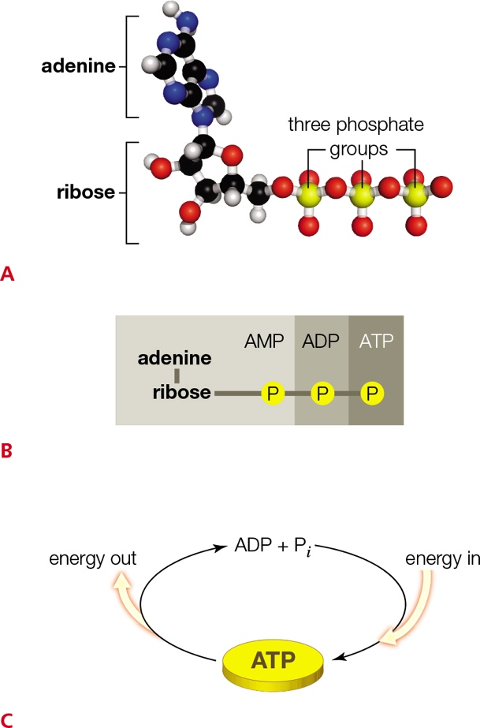
ATP—A Special Coenzyme (3 of 3)
Notes:
Figure 5.20 ATP, an important energy currency in metabolism.
A ATP. Bonds between its phosphate groups hold a lot of energy.
Figure 2.11 A pH scale. Here, red dots signify hydrogen ions (H⁺) and blue dots signify hydroxyl ions (OH–). Also shown are the approximate pH values for some common solutions.
This pH scale ranges from 0 (most acidic) to 14 (most basic). A change of one unit on the scale corresponds to a tenfold change in the amount of H⁺ ions.
B After ATP loses one phosphate group, the nucleotide is ADP (adenosine diphosphate); after losing two, it is AMP (adenosine monophosphate).
C The ATP/ADP cycle. ADP forms in a reaction that removes a phosphate group from ATP (P_{i} is an abbreviation for phosphate group). Energy released in this exergonic reaction drives other reactions that are the stuff of cellular work. ATP forms again in endergonic reactions that phosphorylate ADP.

Slide 41
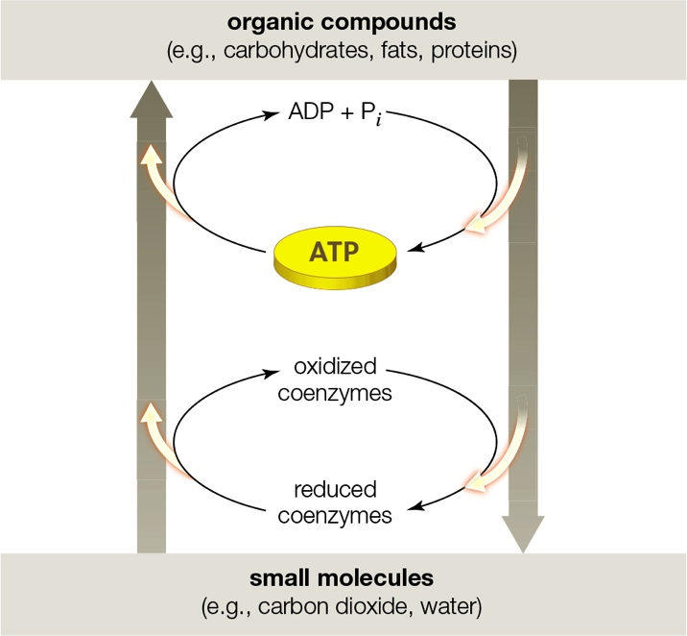
Coupling Endergonic and Exergonic Reactions
Notes:
Figure 5.21 ATP and coenzymes couple endergonic reactions with exergonic reactions. Yellow arrows indicate energy flow. Compare Figures 5.8 and 5.20C.

Slide 42
5.6 Diffusion and Membranes
Diffusion: spontaneous spreading of molecules or atoms
What affects the rate of diffusion?
  Concentration
  Temperature
  Size
  Charge
  Pressure

Slide 43
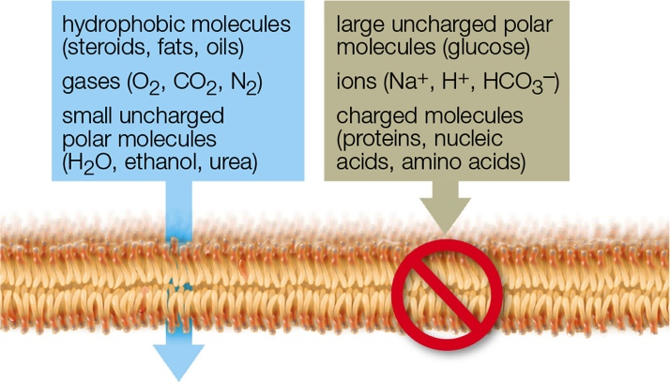
Semipermeable Membranes
Lipid bilayers are selectively permeable
  Water can cross, but ions and most polar molecules cannot
Notes:
Figure 5.22 Selective permeability of lipid bilayers.
Hydrophobic molecules, gases, and small uncharged polar molecules can cross a lipid bilayer on their own. Ions, charged molecules, and large uncharged polar molecules cannot.

Slide 44
Osmosis
Diffusion of water across a selectively permeable membrane
  Occurs in response to a difference in solute concentration (tonicity) between the fluids on either side of the membrane
    Isotonic: equal solute concentrations; no osmosis
    Hypotonic: low solute relative to another fluid; water flows out of hypotonic cytoplasm
    Hypertonic: high solute relative to another fluid; water flows into hypertonic cytoplasm

Slide 45
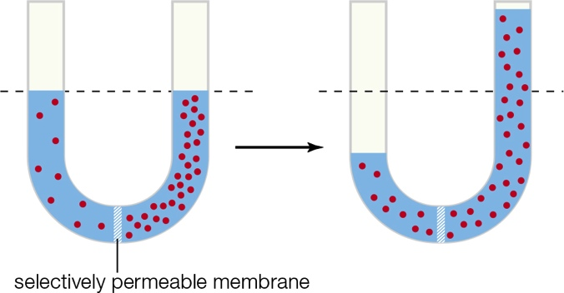
Osmosis = Diffusion of Water
Notes:
Figure 5.23 Osmosis. Water moves across a selectively permeable membrane that separates two fluids of differing tonicity (red dots represent solutes). The volume of fluid in the two compartments changes as water diffuses across the membrane between them.

Slide 46
Effects of Tonicity
Notes:
Figure 5.24 Effects of tonicity. Like a semipermeable bag filled with a solution of sucrose and water (A), red blood cells have no mechanism to compensate for differences in solute concentration across their membrane (B–D).
A What happens when a semipermeable bag containing a solution of water and sucrose is immersed in solutions of different tonicities.
B Red blood cells in an isotonic solution (such as the fluid portion of blood) have an indented disk shape.
C Red blood cells immersed in a hypertonic solution shrivel up because water diffuses out of them.
D Red blood cells immersed in a hypotonic solution swell up because water diffuses into them. Some of these have burst.

Slide 47
Turgor (1 of 2)
Stiff cell walls keep plant cells from expanding very much
  An inflow of water causes pressure to build up
  Turgor: pressure that a fluid exerts against a structure
  Osmotic pressure: amount of turgor that prevents osmosis into cytoplasm or other hypertonic fluid

Slide 48
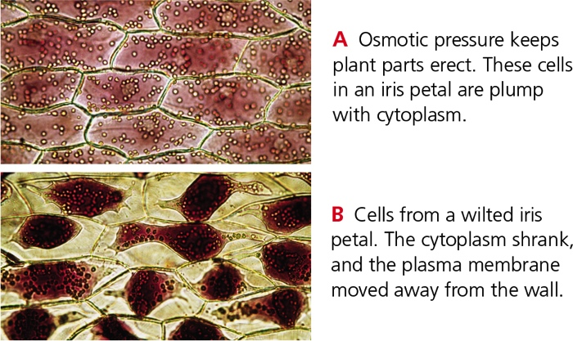
Turgor (2 of 2)
Notes:
Figure 5.25 Turgor, as illustrated in cells of iris petals.

Slide 49
5.7 Membrane Transport Mechanisms (1 of 2)
Transport proteins allow only specific substances to cross the membrane
Passive transport: solutes move through membrane; requires no energy
  Example: facilitated diffusion - solute binds to transport protein and moves across membrane with its concentration gradient

Slide 50
Membrane Transport Mechanisms (2 of 2)
Active transport: transport protein pumps a solute against its concentration gradient; requires energy
  Examples:
    Calcium pumps
    Sodium–potassium pumps

Slide 51
Facilitated Diffusion
Notes:
Figure 5.26 An example of facilitated diffusion.
A A glucose molecule (here, in extracellular fluid) binds to a glucose transporter (gray) in the plasma membrane.
B Binding causes the transport protein to change shape.
C The transport protein releases the glucose on the other side of the membrane (in cytoplasm) and resumes its original shape.

Slide 52
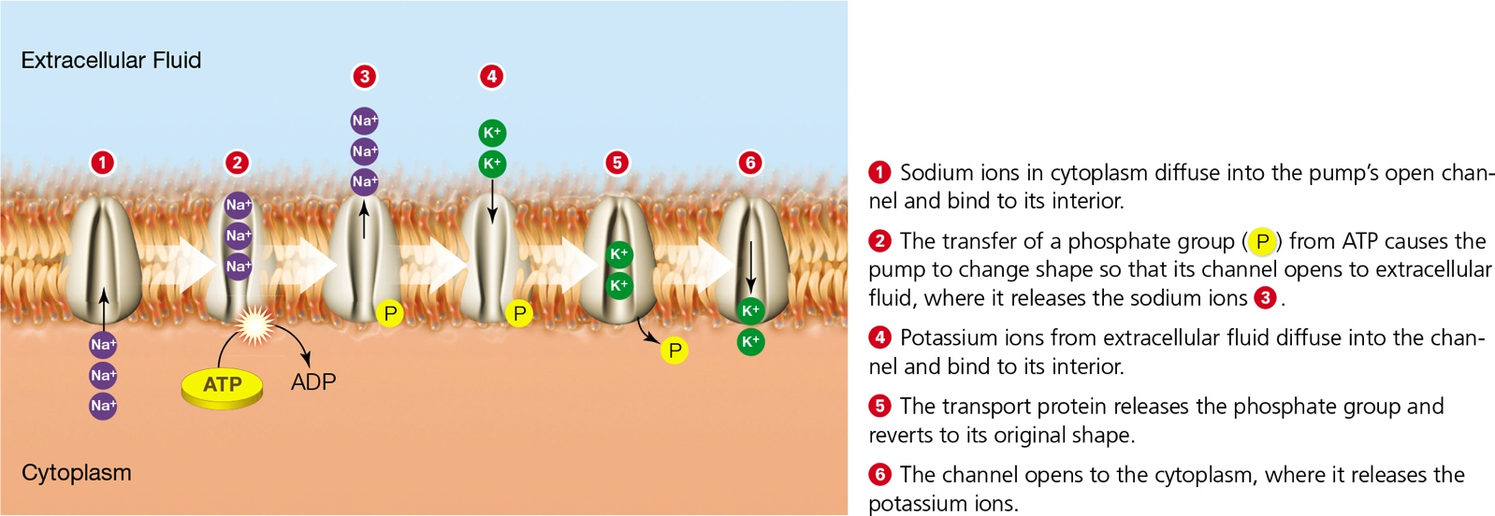
Sodium–Potassium Pump
Notes:
Figure 5.28 The sodium–potassium pump. This transport protein (gray) actively transports sodium ions (Na+) from cytoplasm to extracellular fluid, and potassium ions (K+) in the other direction. The transfer of a phosphate group (P) from ATP provides energy required for transporting the ions against their concentration gradient.

Slide 53
5.8 Membrane Trafficking
Vesicle movement
  Exocytosis: cell expels a vesicle’s contents to extracellular fluid
  Endocytosis: cell takes in a small amount of extracellular fluid (and its contents) by the ballooning inward of the plasma membrane
    Bulk-phase endocytosis
    Receptor-mediated endocytosis

Slide 54
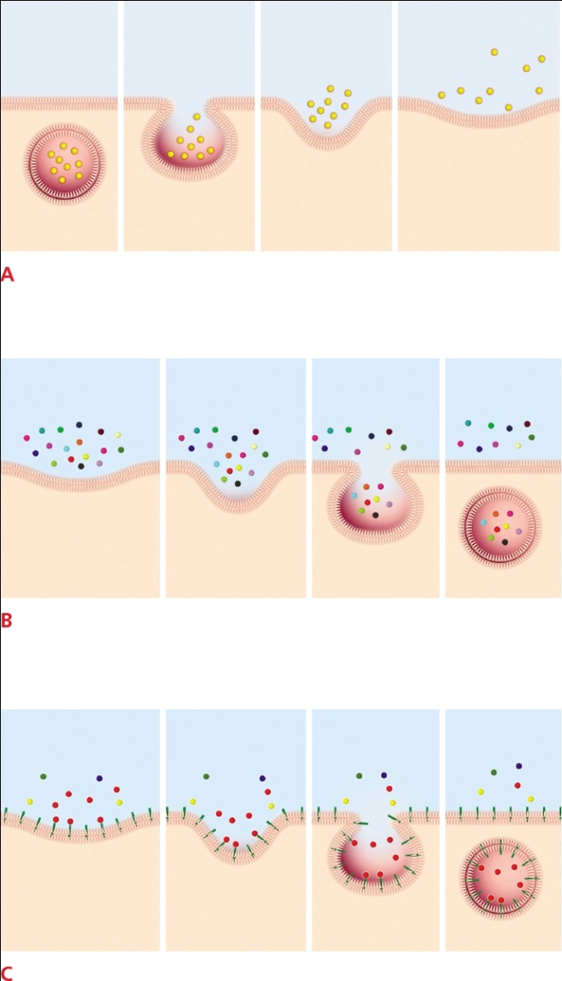
Exocytosis and Endocytosis
Notes:
Figure 5.29 Exocytosis and endocytosis
A Exocytosis. A vesicle in cytoplasm fuses with the plasma membrane. Lipids and proteins of the vesicle’s membrane become part of the plasma membrane as its contents are expelled to external fluid.
B Bulk-phase endocytosis. A pit in the plasma membrane traps molecules, fluid, and particles near the cell’s surface in a vesicle as it deepens and sinks into the cytoplasm.
C Receptor-mediated endocytosis. Receptors on the cell surface bind a target molecule and trigger a pit to form in the plasma membrane. The target molecules are trapped in a vesicle as the pit deepens and sinks into the cell’s cytoplasm. This mode is more selective about what is taken into the cell than bulk-phase endocytosis.

Slide 55
Membrane Recycling
Membrane proteins and lipids are made in the ER and move to the Golgi bodies for final modification
  “Finalized” vesicles containing proteins and lipids move to and fuse with the plasma membrane
Exocytosis and endocytosis continually replace and withdraw membrane patches

Slide 56
Application: A Toast to Alcohol Dehydrogenase
Alcohol abuse continues to be the most serious drug problem on college campuses in the United States
Consuming more alcohol than your enzymes can break down can cause harm to liver cells, interfere with the normal processes of metabolism, and in the long-term, can cause alcoholic hepatitis

Slide 57
Discuss
What would be the result on blood cells if pure water was given intravenously instead of physiological saline?
Based on your knowledge of membranes and solubility, which insecticide preparation would you expect to kill insects faster: one that is water formulated or petroleum-solvent formulated?

