Slide 1
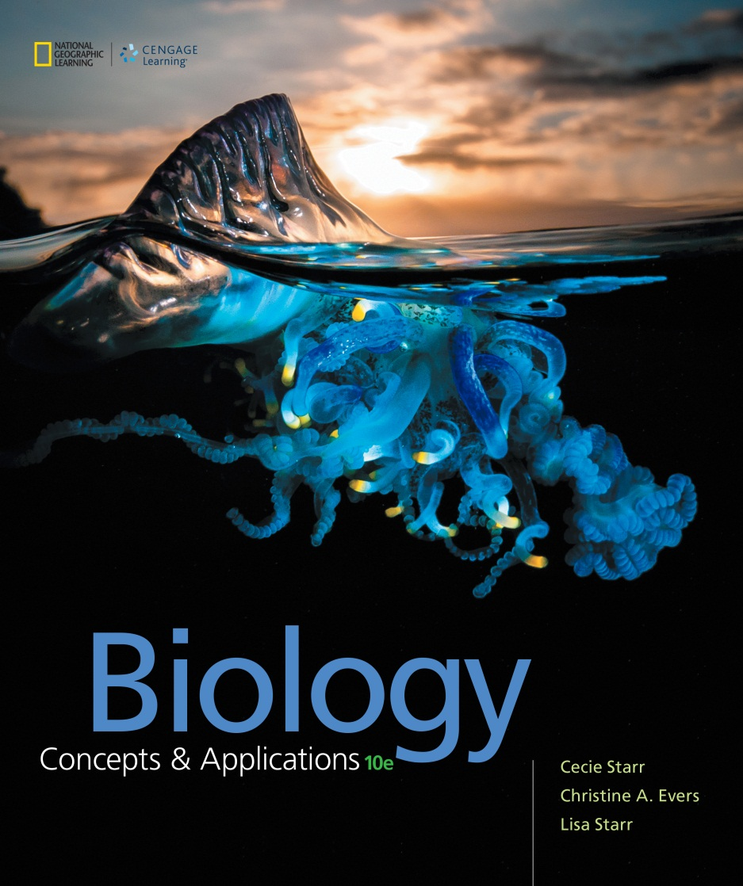
Biology Concepts & Applications
10 Edition
Chapter 4 Cell Structure
Copyright © 2018 Cengage Learning. All Rights Reserved. May not be copied, scanned, or duplicated, in whole or in part, except for use as permitted in a license distributed with a certain product or service or otherwise on a password-protected website for classroom use.

Slide 2
4.1 What, Exactly, Is a Cell?
Cell theory
  Prior to the invention of the microscope, the existence of cells was unknown
  Mid-1600s: Antoni van Leeuwenhoek constructed a crude microscope and observed “animalcules”
    These animalcules were in fact microbes

Slide 3
Cell Theory
TABLE 4.1
Cell Theory
1. Each organism consists of one or more cells.
2. The cell is the structural and functional unit of all organisms. A cell is the smallest unit of life, individually alive even as part of a multicelled organism.
3. All living cells arise by division of preexisting cells.
4. Cells contain hereditary material (DNA), which they pass to their offspring when they divide.
Notes:
Table 4.1 Cell Theory

Slide 4
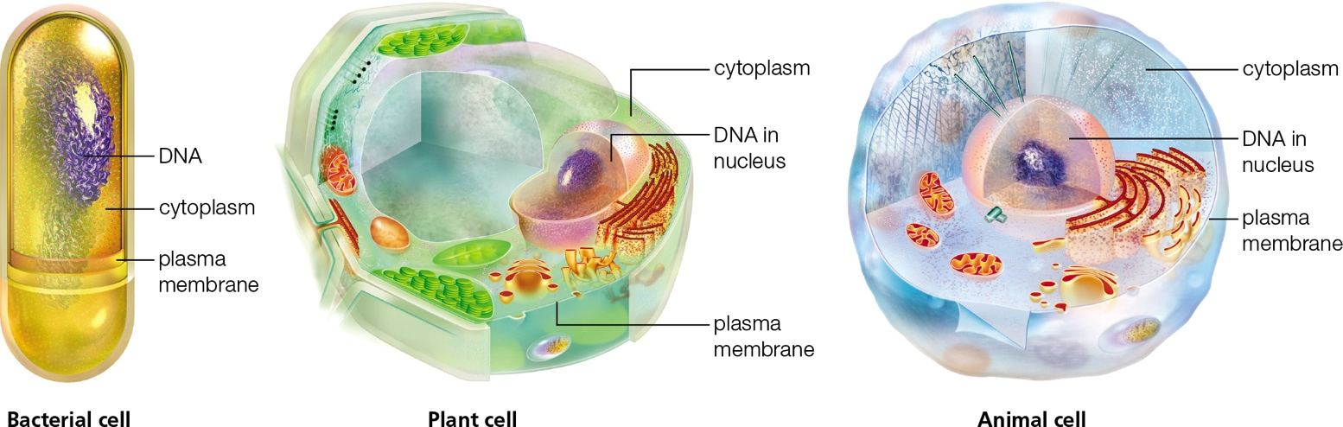
General Organization of a Cell
Notes:
Figure 4.1 Overview of the general organization of a cell.
All cells start out life with a plasma membrane, cytoplasm, and DNA. Archaea are similar to bacteria in overall structure; both are typically much smaller than eukaryotic cells.

Slide 5
Components of All Cells (1 of 2)
All cells have at least three components in common
  Plasma membrane
  Cytoplasm
  DNA

Slide 6
Components of All Cells (2 of 2)
The plasma membrane is the outermost membrane of a cell
The plasma membrane encloses a jelly like mixture called cytoplasm
Suspended in the cytoplasm are specialized organelles
All cells start out life with DNA
  In eukaryotic cells, DNA is contained within the nucleus

Slide 7
Constraints on Cell Size (1 of 2)
Cell size is limited by a physical relationship called the surface-to-volume ratio
  The volume of an object increases with the cube of the diameter
  The surface area increases with the square
When a cell expands in diameter, its volume increases faster than its surface area does

Slide 8
Constraints on Cell Size (2 of 2)
Surface-to-volume limits affect the form of colonial types and multicelled types
Examples:
  Colonial algae cells attach end to end
  Muscle cells are long and thin

Slide 9
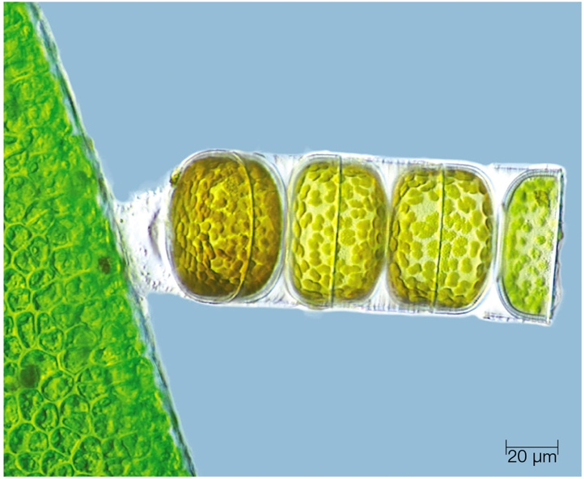
Colonial Organism
Notes:
Figure 4.4 Example of a colonial organism. Sticky secretions hold these pill-shaped algal cells together end to end, forming a long strand. The arrangement allows each cell to exchange substances directly with the surrounding water. Secretions also anchor the strand to a solid surface (such as the plant on the left).

Slide 10
4.2 How We See Cells
Most cells are 1–100 micrometers in diameter
  Much smaller than the unaided human eye can perceive
Microscopes are used to observe objects in the micrometer range of size

Slide 11
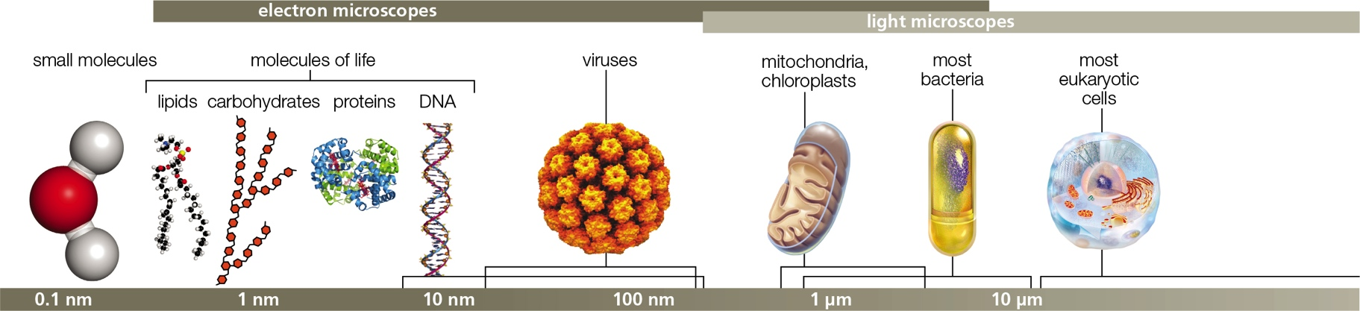
Relative Sizes (1 of 2)
Notes:
Figure 4.5 Relative sizes. The diameter of most cells is between 1 and 100 micrometers.
See also Table 4.2 and Appendix VI, Units of Measure.

Slide 12
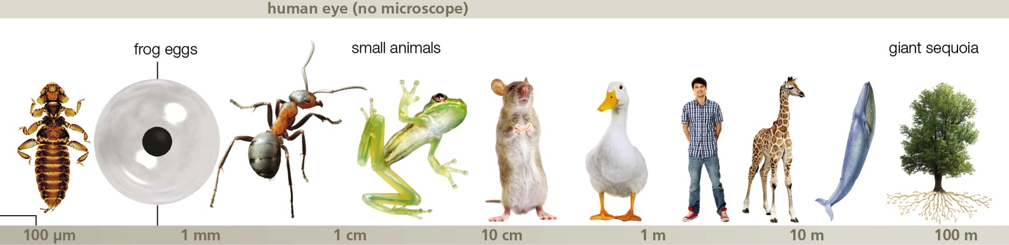
Relative Sizes (2 of 2)
Notes:
Figure 4.5 Relative sizes. The diameter of most cells is between 1 and 100 micrometers.
See also Table 4.2 and Appendix VI, Units of Measure.

Slide 13
Microscopes
Light microscopes use visible light to illuminate samples
  Curved lenses inside the microscope focus light into a magnified image
  Researchers use stains or light-emitting tracers to see the details inside cells
Electron microscopes use magnetic fields to focus a beam of electrons onto a sample

Slide 14
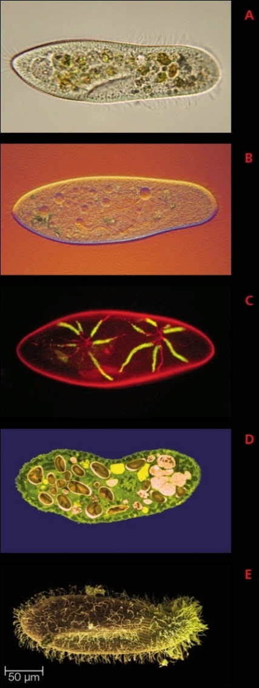
Different Techniques, Different Views
Notes:
Figure 4.6 Different microscopy techniques reveal different characteristics. All of these micrographs show the same organism, a protist called Paramecium that is about 250 µm long.
A Green blobs visible in this light micrograph of a living cell are ingested algae. Hairlike surface structures are cilia that propel this motile organism through fluids.
B A light micrograph taken with polarized light shows edges in relief. This technique reveals ingested algae and some internal structures not visible in A.
C In this fluorescence micrograph, yellow pinpoints the location of a particular protein in the membrane of organelles called contractile vacuoles (also visible in B).
D A colorized transmission electron micrograph reveals several types of internal structures. Ingested algae are being broken down inside food vacuoles.
E A scanning electron micrograph shows details of the cell’s surface, including its thick coat of cilia. The cell takes in food via the indentation (also visible in A).

Slide 15
4.3 Cell Membrane Structure
The plasma membrane’s function is not limited to physically separating a cell’s external environment from its internal one
Other functions include regulating the crossing of substances into and out of cells

Slide 16
The Fluid Mosaic Model
Several molecules are embedded within or attached to the lipid bilayer:
  Cholesterol, proteins, glycoproteins,and glycolipids
Fluid mosaic: model of a cell membrane as a two-dimensional fluid of mixed composition

Slide 17
Cell Membrane Structure
A In a watery fluid, phospholipids spontaneously line up into two layers: the hydrophobic tails cluster together, and the hydrophilic heads face outward, toward the fluid. This lipid bilayer forms the framework of all cell membranes. Many types of proteins intermin­gle among the lipids; a few that are typical of plasma membranes are shown on the opposite page.
Notes:
Figure 4.7 Cell membrane structure.
A Organization of phospholipids in cell membranes.

Slide 18
Proteins Add Function
Many types of proteins are associated with a cell membrane
  Adhesion proteins: helps cells stick together
  Recognition proteins: identifies “self” cells
  Receptor proteins: triggers a change in cell activity
  Transport proteins: assists the movement of ions or molecules across the membrane

Slide 19
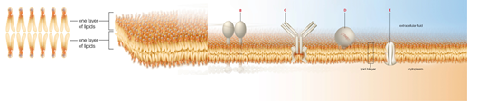
Membrane Proteins
Notes:
Figure 4.7 Cell membrane structure.
B–E Examples of common membrane proteins. Many membrane proteins have an extremely complex structure; for clarity, they are often modeled as blobs or geometric shapes.
B Adhesion proteins fasten cells together or to external proteins. This one connects protein filaments inside the cell to external filaments.
C Receptor proteins trigger a change in cellular activity in response to a stimulus such as binding to a particular substance. This one occurs on cells of the immune system.
D Enzymes speed reactions at membranes. This one is part of a membrane-bound set of molecules that together break down drugs and other organic toxins.
E Transport proteins bind to molecules on one side of the membrane and release them on the other side. This one transports glucose.

Slide 20
4.4 Introducing the Prokaryotes
All bacteria and archaea are single-celled organisms
Archaea and bacteria were once formally grouped together as prokaryotes
  Archaea are more closely related to eukaryotes than to bacteria
Archaea now have their own separate domain

Slide 21
Bacteria and Archaea
Notes:
Figure 4.8 Some representatives of bacteria (A–C) and an archaeon (D).
A Escherichia coli is a common bacterial inhabitant of human intestines. Short, hairlike structures are pili; longer ones are flagella. This one is harmless; others can cause disease in humans.
B Dermocarpa is a type of cyanobacteria, an ancient lineage of photosynthetic bacteria. Photosynthesis occurs at internal membranes (green). The dark, multisided structures are carboxysomes, protein enclosed organelles that assist photosynthesis.
C Helicobacter pylori is a spiral-shaped bacterium that can cause ulcers and cancer when it infects the lining of the stomach. It can take on a ball-shaped form (shown) that offers protection from environmental challenges such as exposure to an antibiotic.
D The archaeon Thermococcus gammatolerans lives under extreme conditions of salt, temperature, and pressure. It is by far the most radiation resistant organism ever discovered, capable of withstanding thousands of times more radiation than humans can.

Slide 22
Structural Features (1 of 2)
Structural similarities between bacteria and archaea
  Protein filaments reinforce cell shape
  Numerous ribosomes for protein synthesis
  Cytoplasm contains plasmids (small circular DNAs)
  DNA is concentrated in a nucleoid

Slide 23
Structural Features (2 of 2)
  Rigid cell wall surrounds the plasma membrane
  Polysaccharides form a slime layer or capsule around cell wall
  Pili (protein filaments) project from the surface
  Long, slender cellular structures called flagella are used for motion

Slide 24
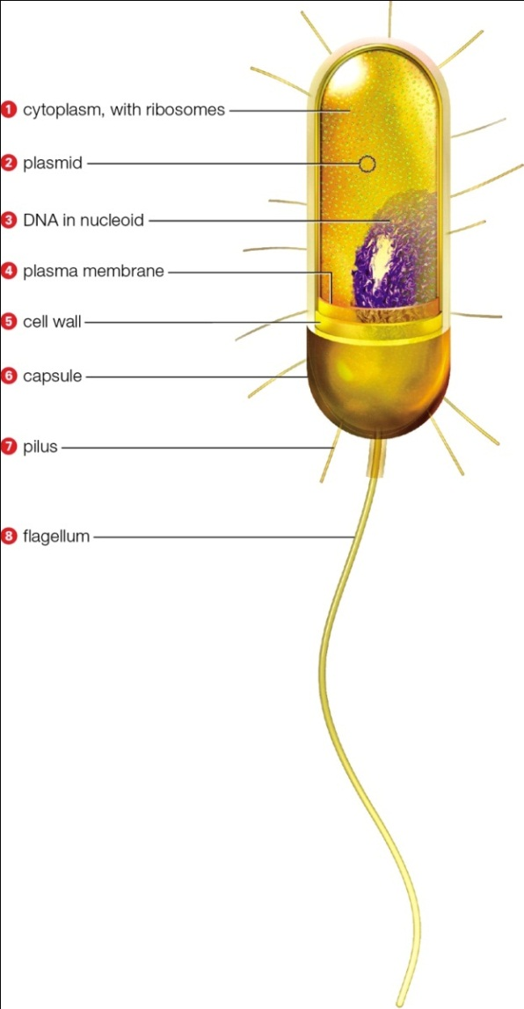
Generalized Bacterial Body Plan
Notes:
Figure 4.9 Generalized body plan of bacteria. Archaea do not have capsules, but otherwise they appear very similar to bacteria—at least outwardly. Their molecular architecture differs significantly.

Slide 25
Biofilms
Bacterial cells often share a layer of secreted polysaccharides and proteins
  Biofilm: community of microorganisms living within a shared mass of secreted slime
A biofilm is often attached to a solid surface and may include:
  Bacteria, algae, fungi, protists, and/or archaea

Slide 26
4.5 Introducing the Eukaryotic Cell
TABLE 4.4
Some Components of Eukaryotic Cells
Organelles with membranes
Nucleus | Protects and controls access to DNA
Endoplasmic reticulum (ER) | Makes and modifies new polypeptides and lipids, among other
Golgi body | Modifies and sorts polypeptides and lipids
Vesicle | Transports, stores, or breaks down substances
Mitochondrion | Makes ATP by glucose breakdown
Chloroplast | Makes sugars (in plants and some protists)
Lysosome | Intracellular digestion
Peroxisome | Breaks down fatty acids, amino acids, toxins
Vacuole | Stores, breaks down substances
Organelles without membranes
Ribosome | Assembles polypeptides
Centriole | Anchors cytoskeleton
Other components
Cytoskeleton | Contributes to cell shape, internal organization, movement
Notes:
Table 4.4 Some Components of Eukaryotic Cells

Slide 27
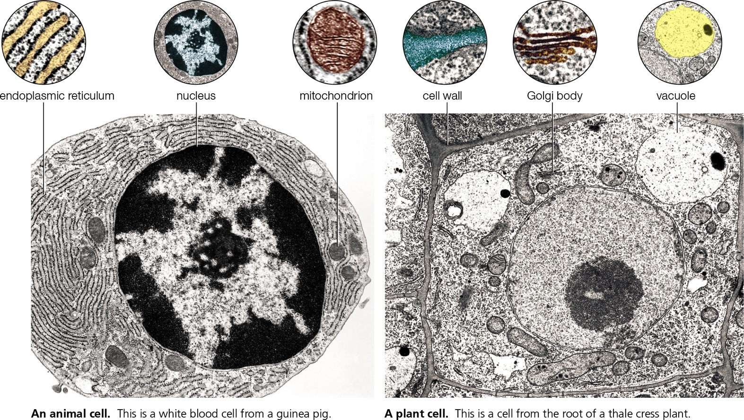
General Features of Eukaryotic Cells
Notes:
Figure 4.11 Some components of typical eukaryotic cells.

Slide 28
The Nucleus
The nucleus protects DNA from the metabolic processes of the cell
Nuclear envelope: outer boundary of the nucleus; controls access to DNA
Nucleoplasm: viscous fluid enclosed by the nuclear envelope
Nucleolus: dense, irregularly shaped region where ribosomal subunits are assembled

Slide 29
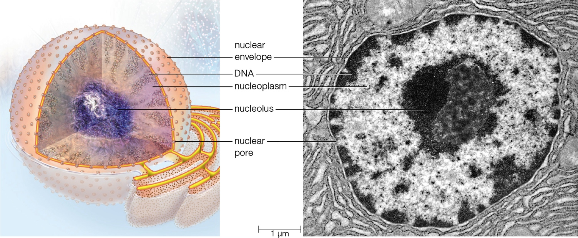
The Cell Nucleus
Notes:
Figure 4.12 The cell nucleus.

Slide 30
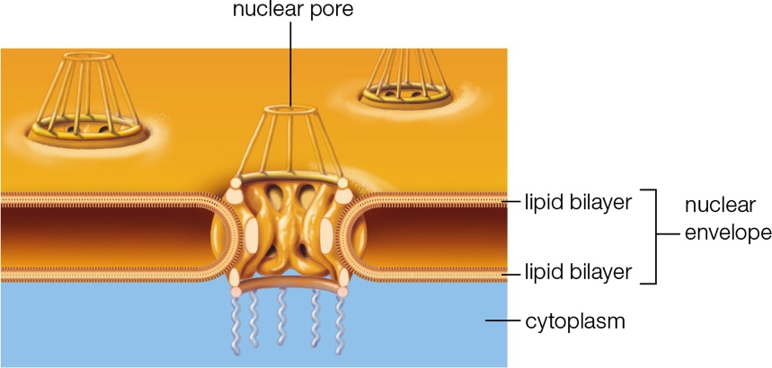
Nuclear Envelope
Notes:
Figure 4.13 The nuclear envelope. The nuclear envelope consists of two lipid bilayers folded together as a single membrane. The envelope is studded with thousands of nuclear pores, each an organized cluster of membrane proteins. Nuclear pores selectively allow certain substances to cross the membrane.

Slide 31
4.6 The Endomembrane System (1 of 2)
Endomembrane system
  Series of interacting organelles between nucleus and plasma membrane
    Endoplasmic reticulum, Golgi bodies, and vesicles
  Produces lipids and proteins

Slide 32
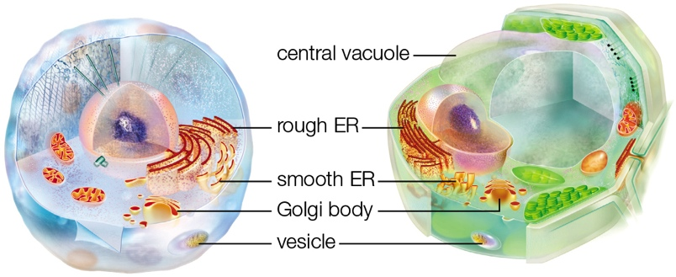
4.6 The Endomembrane System (2 of 2)

Slide 33
A Variety of Vesicles (1 of 2)
Vesicle: small, membrane-enclosed organelle
Functions
  Transports substances
  Collects and disposes of waste, debris, or toxins

Slide 34
A Variety of Vesicles (2 of 2)
Peroxisome: breaks down amino acids, fatty acids, and toxic substances
Lysosome: breaks down cellular wastes and debris
Vacuoles: fluid filled; isolates or disposes of waste, debris, or toxic materials
Central vacuole: fluid-filled vesicle in many plant cells

Slide 35
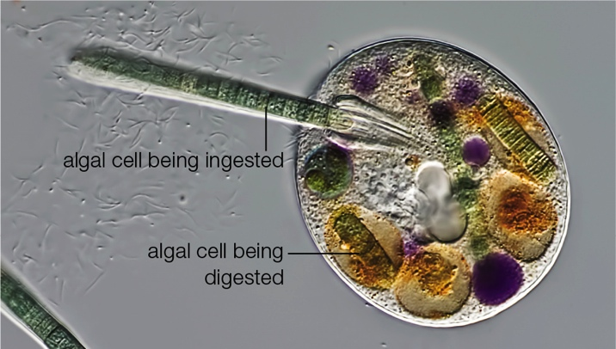
Vesicle Function
Notes:
Figure 4.15 An example of vesicle function. Nassula (round cell) is a protist that uses a distinctive oral basket to feed on strands of photosynthetic algae (green). Ingested cells are delivered to lysosomes for digestion; they change color (green to purple to brown to gold) as chlorophyll molecules inside them are broken down.

Slide 36
Endoplasmic Reticulum
Endoplasmic reticulum (ER): A continuous system of sacs and tubes extending from the nuclear envelope
  Smooth ER: makes lipids and breaks down carbohydrates and fatty acids
  Rough ER: ribosomes on the surface synthesize proteins

Slide 37
Golgi Bodies
Golgi body
  Modifies proteins
  Packages the finished products into vesicles
  Some of the vesicles deliver their cargo to the plasma membrane; others become lysosomes

Slide 38
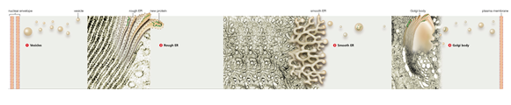
The Endomembrane System
Notes:
Figure 4.14 The endomembrane system.
1 Vesicles are membrane-enclosed sacs that form by budding from the plasma membrane or from other organelles. Many transport substances among organelles of the ER, and to and from the plasma membrane. Lysosomes, peroxisomes, and vacuoles store or break down substances and particles.
2 Rough ER Ribosomes attached to the surface of rough ER give it a “rough” appearance. Polypeptides assembled on the ribosomes thread into ER’s interior, where they take on their tertiary structure and assemble with other polypeptides.

Slide 39
4.7 Mitochondria
Mitochondrion: double-membraned organelle that produces ATP by aerobic respiration in eukaryotes
Nearly all eukaryotic cells (including plant cells) have mitochondria
  The number varies by the type of cell and by the organism

Slide 40
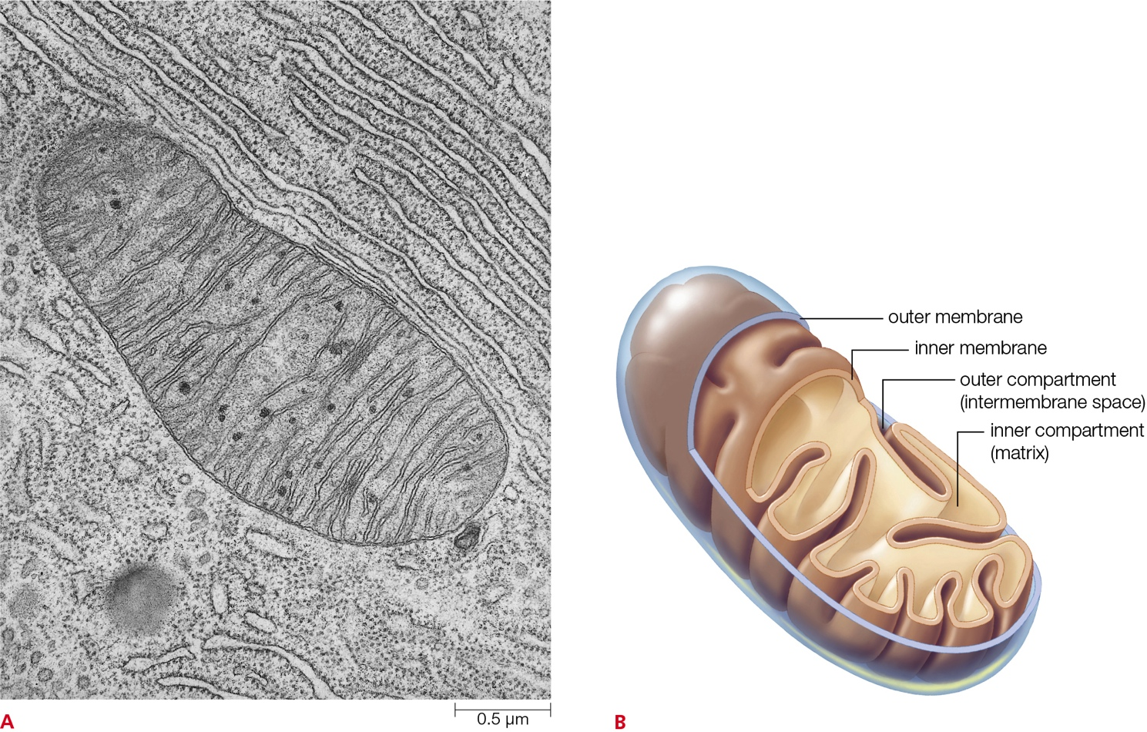
The Mitochondrion
Notes:
Figure 4.16 The mitochondrion. This eukaryotic organelle specializes in producing ATP.
A Mitochondrion in a cell from bat pancreas.
B Each mitochondrion has two membranes, one highly folded inside the other. The inner compartment formed by these membranes is called the mitochondrial matrix; the outer compartment is called the intermembrane space.

Slide 41
4.8 Chloroplasts and Other Plastids
Plastids: double-membraned organelles that function in photosynthesis, storage, or pigmentation in plant and algal cells
  Examples: chloroplasts, chromoplasts, amyloplasts
  Chloroplasts: specialized plastid for photosynthesis in some protists and plant cells

Slide 42
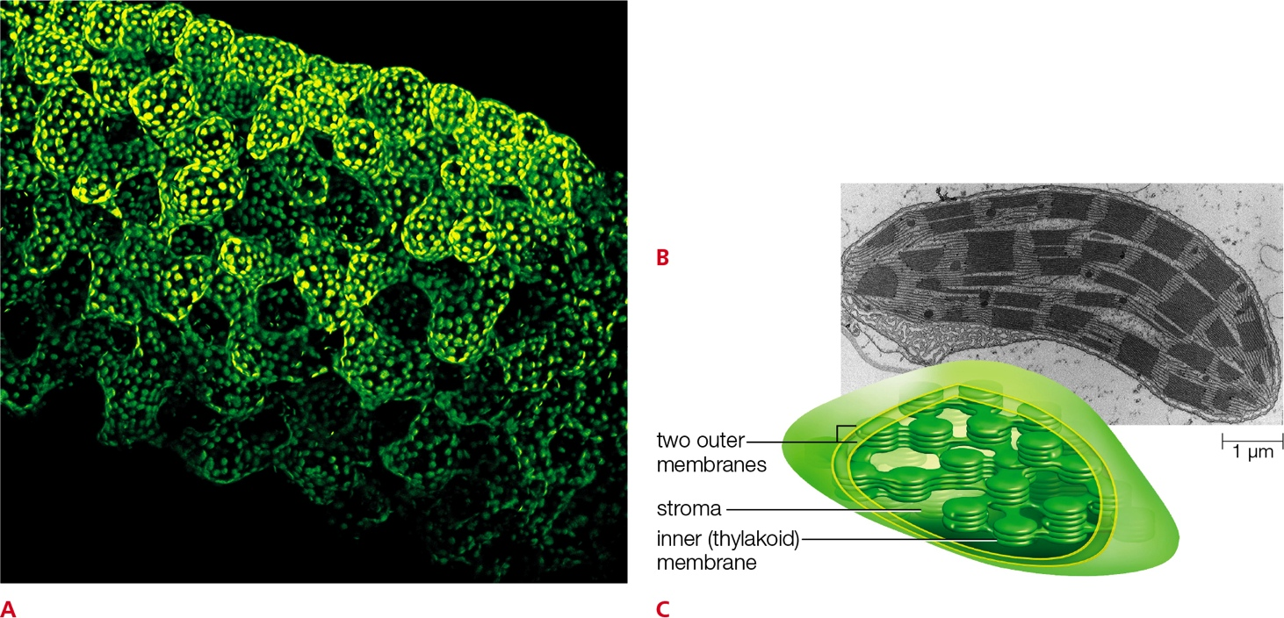
The Chloroplast
Notes:
Figure 4.17 The chloroplast.
A Chloroplast-packed cells make up a leaf of a flowering plant.
B Chloroplast from a leaf of corn, TEM.
C Each chloroplast has two outer membranes. Photosynthesis occurs at a third, highly folded inner membrane that is called the thylakoid membrane.

Slide 43
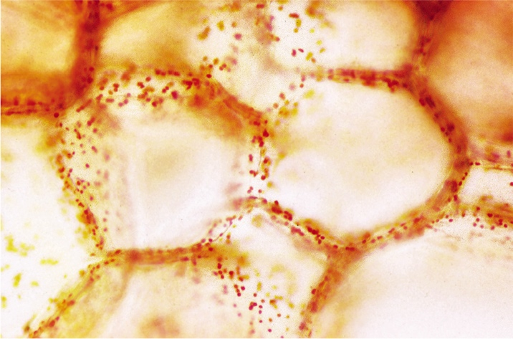
Chromoplasts
Notes:
Figure 4.18 Chromoplasts. The color of a red bell pepper (a fruit) arises from carotenoid-containing chromoplasts in its cells.

Slide 44
4.9 The Cytoskeleton
Cytoskeleton
  Network of interconnected protein filaments
  Supports, organizes, and moves eukaryotic cells and their parts

Slide 45
Cytoskeletal Elements
Microtubules: hollow filament of tubulin subunits
  Involved in movement
Microfilaments: fiber of actin subunits
  Reinforces membranes; involved in muscle contractions
Intermediate filament: stable cytoskeletal element
  Structurally supports membranes and tissues

Slide 46
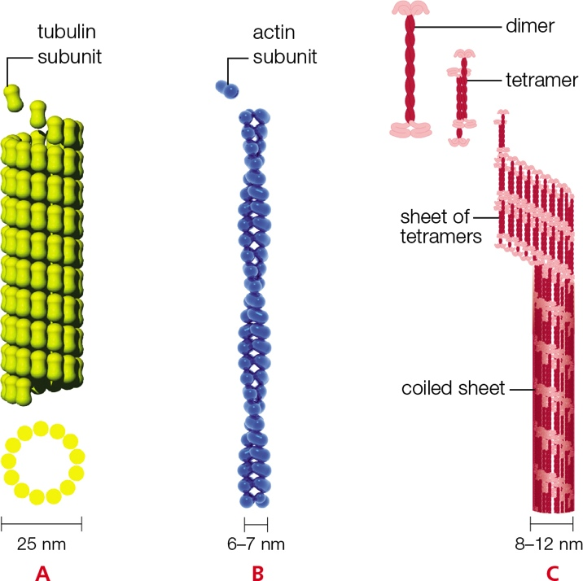
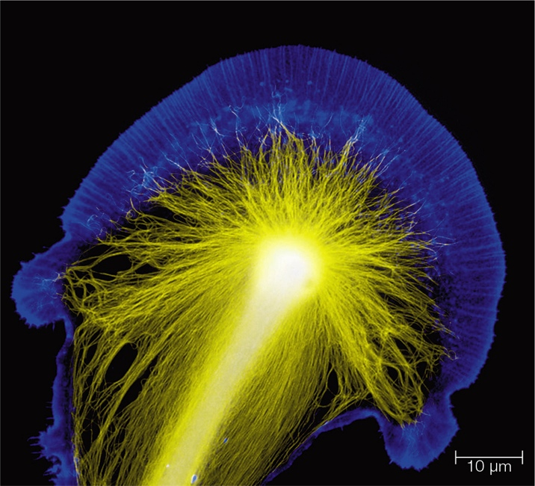
Cytoskeleton
Notes:
Figure 4.19 Cytoskeletal elements.
A Microtubule Involved in moving cell parts or the whole cell.
B Microfilament Reinforces cell membranes; functions in muscle contraction.
C Intermediate filament Structurally supports cell membranes and tissues. Most stable element.
Figure 4.20 Cytoskeletal elements in a nerve cell. This fluorescence micrograph shows microtubules (yellow) and microfilaments (blue) in the growing end of a nerve cell. These cytoskeletal elements support and guide the cell’s lengthening in a particular direction.

Slide 47
Cellular Movement (1 of 3)
Motor proteins
  Associate with cytoskeletal elements
  Move cell parts when energized by a phosphate-group transfer from ATP
  Drag cellular cargo along tracks of microtubules and microfilaments
Notes:
Figure 4.21 A motor protein. Kinesin (tan) drags a vesicle (pink) along a microtubule.

Slide 48
Cellular Movement (2 of 3)
Flagella: propel cells
Cilia: short, movable structures that project from the plasma membrane
Centriole: barrel-shaped organelle from which microtubules grow
Basal body: develops from a centriole
Pseudopod: temporary protrusion; facilitates movement and engulfs prey

Slide 49
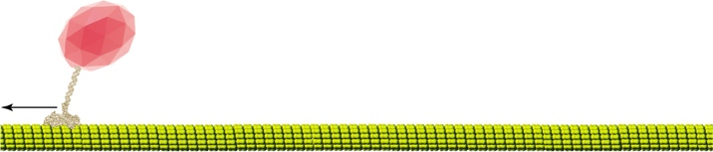
Cellular Movement (3 of 3)
Notes:
Figure 4.21 A motor protein. Kinesin (tan) drags a vesicle (pink) along a microtubule.

Slide 50
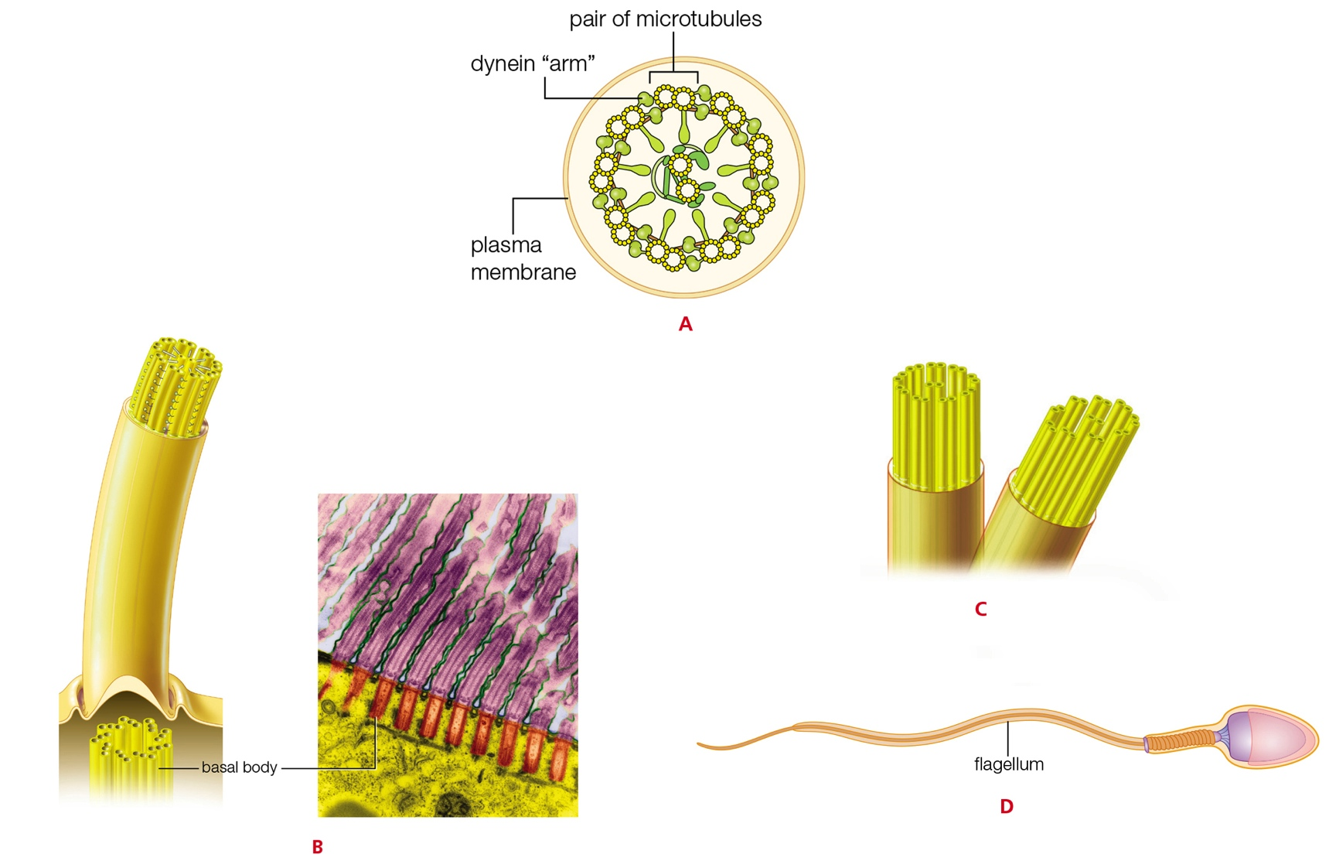
How Eukaryotic Flagella and Cilia Move
Notes:
Figure 4.22 How eukaryotic flagella and cilia move.
A A 9+2 array consists of a ring of nine pairs of microtubules plus one pair at their core. Stabilizing spokes and linking elements connect the microtubules and keep them aligned in this pattern. Projecting from each pair of microtubules are “arms” of the motor protein dynein.
B Microtubules of a developing 9+2 array grow from a centriole, which remains under the finished array as a basal body. The micrograph below shows basal bodies underlying cilia of the protist pictured in Figure 4.6.
C Phosphate-group transfers from ATP cause the dynein arms in a 9+2 array to repeatedly bind the adjacent pair of microtubules, bend, and then disengage. The dynein arms “walk” along the microtubules, so adjacent microtubule pairs slide past one another. The short, sliding strokes of the dynein arms occur in a coordinated sequence around the ring, down the length of the microtubules. The movement causes the entire structure to bend.
D A 9+2 array gives rise to a whiplike motion that can propel mobile eukaryotic cells such as sperm through fluid surroundings.

Slide 51
4.10 Cell Surface Specializations
Extracellular matrix: complex mixture of cell secretions
  Example: cell wall
    Primary wall: first cell wall of young plant cells
    Secondary wall: lignin-reinforced wall that forms inside the primary wall of a plant cell
      Lignin: stiffens cell walls of vascular plants

Slide 52
Extracellular Matrix
Basement membrane: secreted by some animal cells
  Fibrous material that supports and organizes tissue
Cuticle: secreted covering at a body surface
  In plants, a cuticle of waxes and proteins helps stems and leaves fend off insects and retain water

Slide 53
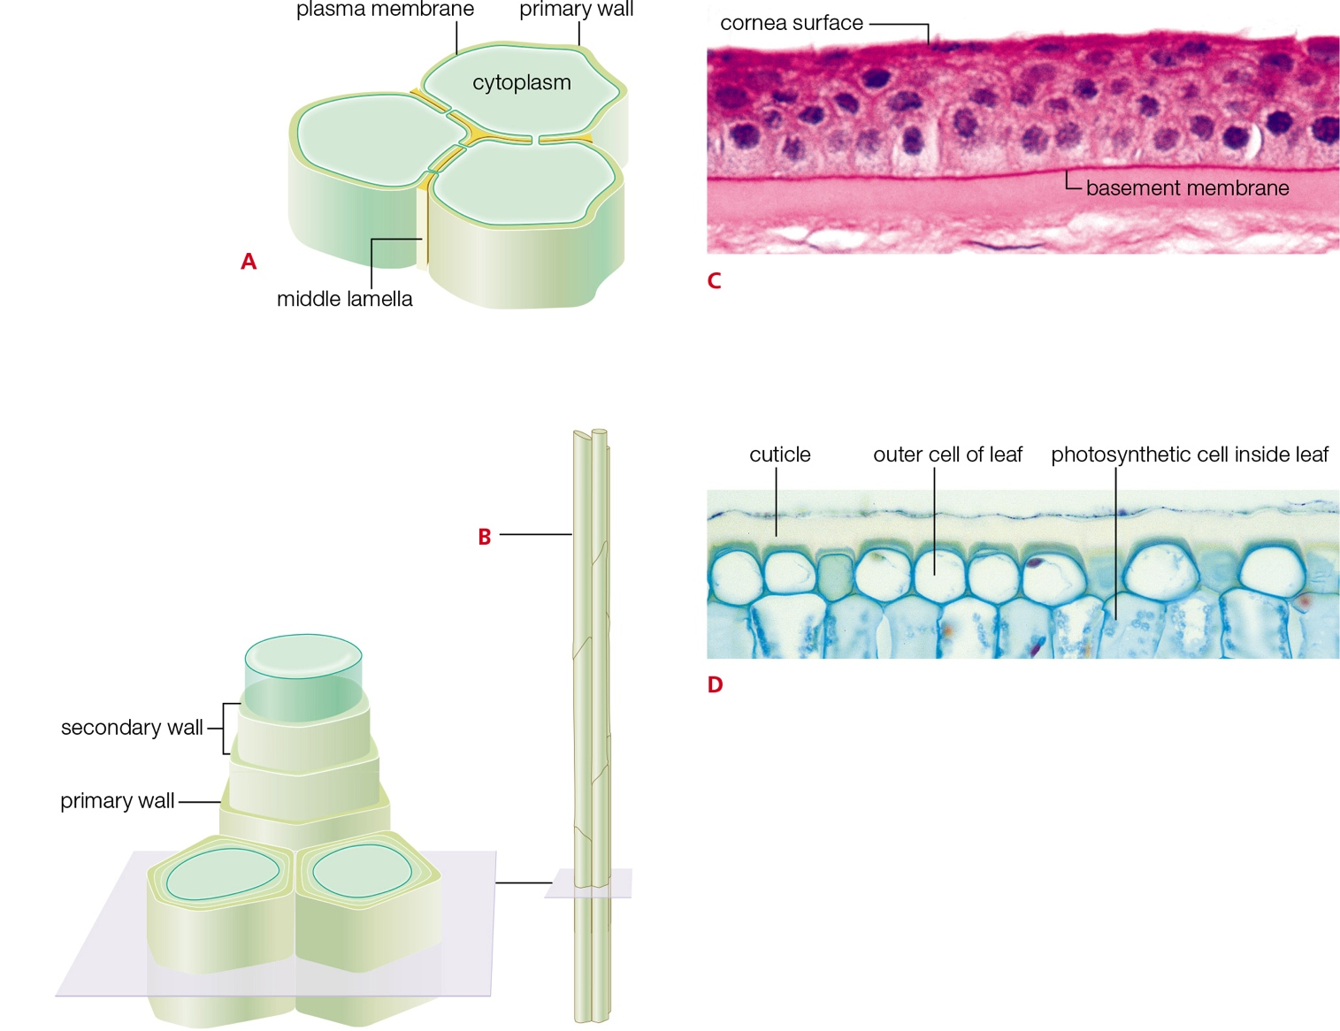
Extracellular Matrix Examples
Notes:
Figure 4.23 Examples of extracellular matrix.
A Plant cell secretions form a primary wall. The middle lamella cements adjoining cells together.
B Plant cells also secrete materials in layers on the inner surface of their primary wall. These layers form a sturdy secondary wall. In some tissues, the wall remains after the cells die, becoming part of pipelines that carry water through the plant.
C In this section of human cornea (a part of the eye), basement membrane is visible as a dark line underlying the cells.
D Section through a plant leaf showing cuticle, a protective covering secreted by living cells.

Slide 54
Cell Junctions (1 of 2)
Cell junction: connects a cell to another cell or to an extracellular matrix
Tight junction: adhesion proteins that join epithelial cells
  Prevents fluids from leaking between cells

Slide 55
Cell Junctions (2 of 2)
Adhering junctions: connect to cytoskeletal elements
  Fastens cells to each other and basement membrane
Gap junctions: channels formed across the plasma membranes of adjoining animal cells
Plasmodesmata: open channel formed between the cytoplasm of adjacent plant cells

Slide 56
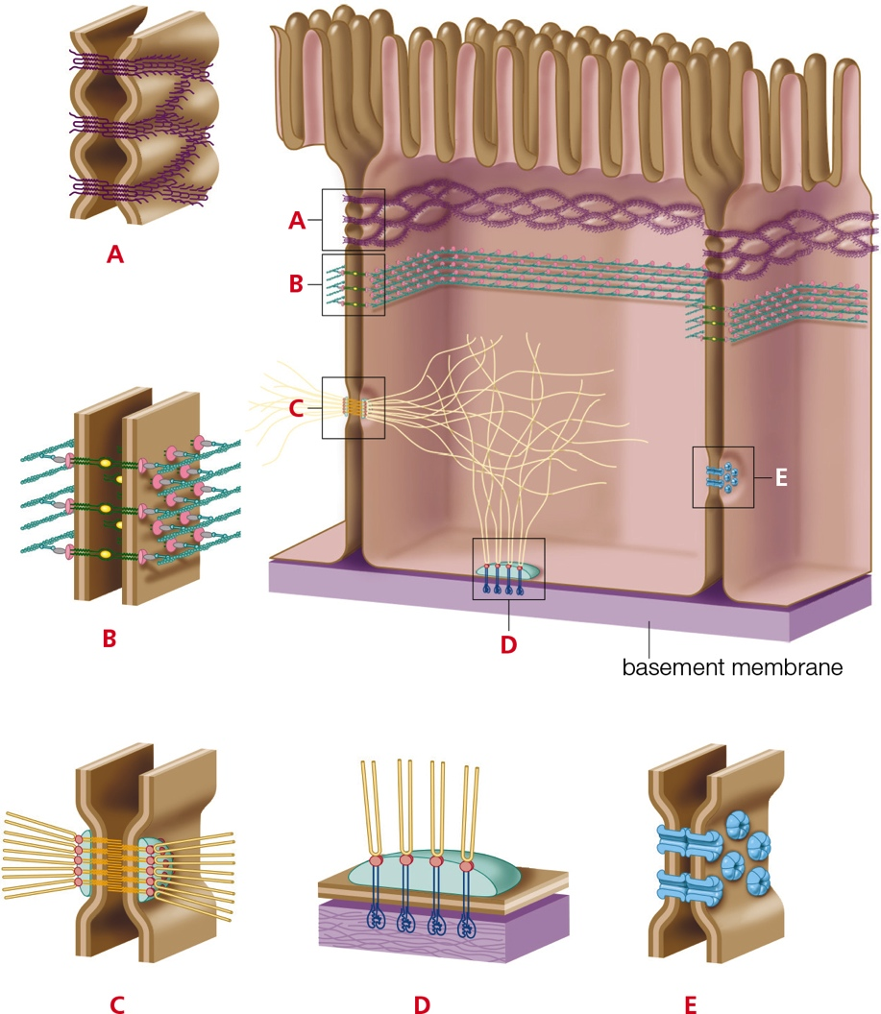
Cell Junctions in Animal Cells
Notes:
Figure 4.24 Cell junctions in animal tissues. Three types of cell junctions are shown: tight junctions (A), adhering junctions (B, C, and D), and gap junctions (E).
A Tight junctions form a waterproof seal between plasma membranes of adjacent cells.
B These adhering junctions connect the plasma membranes of adjacent cells to microfilaments inside the cells.
C These adhering junctions connect the plasma membranes of adjacent cells to intermediate filaments inside the cells.
D These adhering junctions attach the plasma membrane of a cell to basement membrane and to intermediate filaments inside the cell.
E Gap junctions are closable channels that connect the cytoplasm of adjacent cells.

Slide 57
4.11 The Nature of Life
“Life” is a long list of properties that collectively describe living things
TABLE 4.5
Collective properties of Living
A living system:
Consists of one or more cells
Harvests matter and energy from the environment
Requires water
Makes and uses complex carbon-containing molecules
Engages in self-sustaining biological processes such as homeostasis and metabolism
Has the capacity to respond to internal and external stimuli
Has the capacity for growth
Changes over its lifetime, for example by maturing and aging Passes hereditary material (DNA) to offspring
Passes hereditary material (DNA) to offspring
Has the capacity to adapt to environmental pressures over successive generations
Notes:
Table 4.5 Collective Properties of Living Systems

Slide 58
Application: Food for Thought
Strains of E. coli that are toxic to people live in the intestines of other animals
  Humans are exposed when they come into contact with feces of animals that harbor it
    Example: eating contaminated ground beef or contaminated fresh fruits and vegetables
Food workers are working to reduce the number and scope of harmful E. coli outbreaks

Slide 59
Discuss
Why do we use the fluid mosaic model to describe the plasma membrane?
Why do unicellular protists (such as Paramecium) not burst even though their cell interiors are hypertonic to their freshwater environments?
What feature makes a eukaryotic cell a “true” cell?

