Slide 1
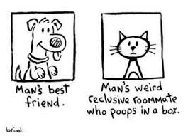

Slide 2
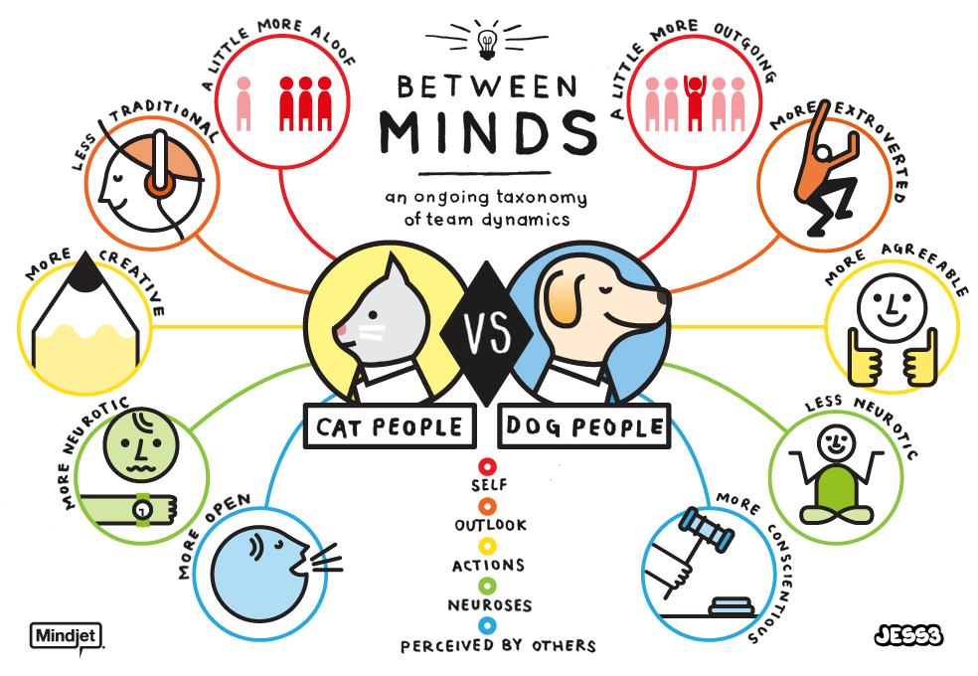

Slide 3
http://www.playbuzz.com/petcarerx10/are-you-a-cat-person-or-a-dog-person

Slide 4
DEBATE
Domestic cat ownership and activity should be stringently regulated in an effort to minimize loss of native fauna.

Slide 5
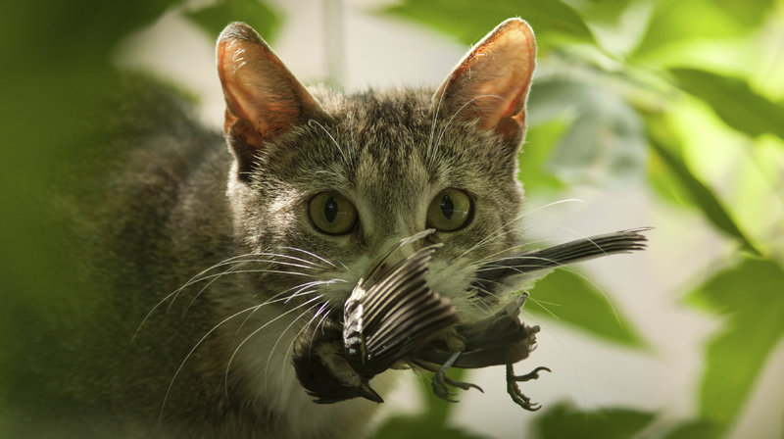
RESEARCH http://www.npr.org/2013/01/29/170588511/killer-kitties-cats-kill-billions-every-year

Slide 6
Formulate.
Assume the role of community policy makers in an affluent town surrounded by native forests with significant biodiversity of small native animals. Pet ownership is high. Forest managers have documented significant wildlife loss at the hands (claws) of roaming domestic cats.
Cat lovers. In an effort to minimalize further loss of biodiversity, regulations must be implemented to control cats. What regulations would you suggest?

Slide 7
Formulate.
Assume the role of community policy makers in an affluent town surrounded by native forests with significant biodiversity of small native animals. Pet ownership is high. Forest managers have documented significant wildlife loss at the hands (claws) of roaming domestic cats.
Native fauna lovers. In an effort to minimalize further loss of biodiversity, regulations must be implemented to control cats. What regulations would you suggest?

Slide 8
NEGOTIATE
Negotiate with the other policy makers to establish a set of agreeable, feasible, enforceable town ordinances that would limit pet ownership and activities and protect the native biodiversity of the region.

Slide 9
PREPARE
Prepare a letter/flyer/informational document to be sent to residents, informing them of:
New Regulations
Justification
Penalties
Data
Other relevant information.

